Slide 1
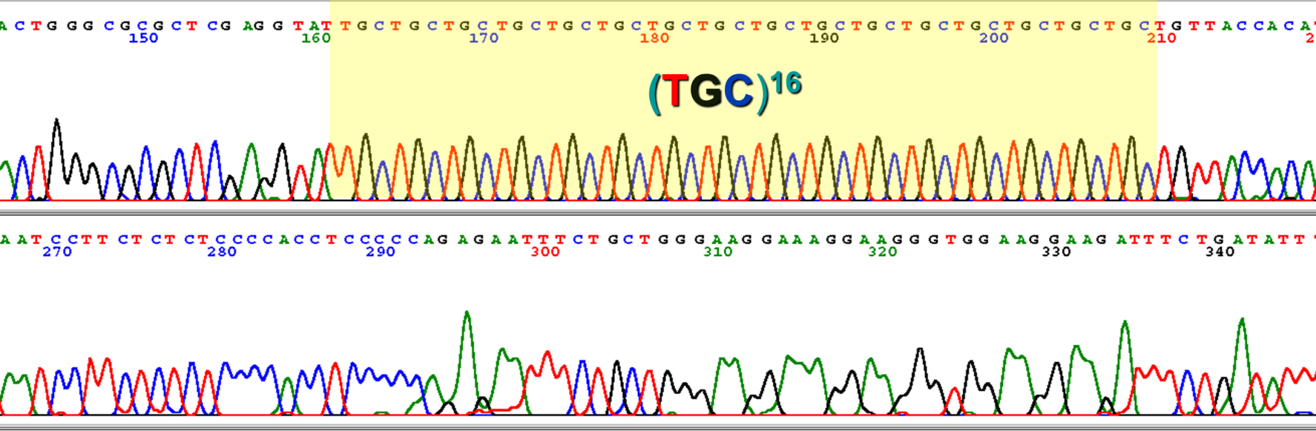
Lab 9: Introduction to Microsatellites and Measuring Genetic Distance
BIOL4174/5174 Conservation Genetics Spring 2018

Slide 2
Microsatellites
Short, repeating DNA sequences spread throughout the genome
‘Short tandem repeats (STR)’ or ‘Simple sequence repeats (SSR)’
Repeats of short motif of 2-6 bases (e.g. ATATATATATATAT or GCAGCAGCAGCAGCAGCA)
Mutations add or remove repeats

Slide 3
Microsatellites

Slide 4
Microsatellites – High mutation rates
High mutation rate = lots of fine-scale variation

Slide 5
Utility of ‘fast-evolving’ markers
Fine-scale population structure within species
Examining admixture between populations/ identifying contemporary migrants
Infer recent demographic history (e.g. bottlenecks)
Inbreeding/ relatedness of individuals
All types of questions in which slower-evolving markers would yield insufficient signal (e.g. too short timescale for mutations to accumulate)

Slide 6
How do we sequence them?
PCR-amplify them with dye-labeled primers
Measure fragment size for each amplified fragment (different fragment lengths = different alleles)
Nowadays we do this with automated sequencer… Used to run manually on a gel

Slide 7
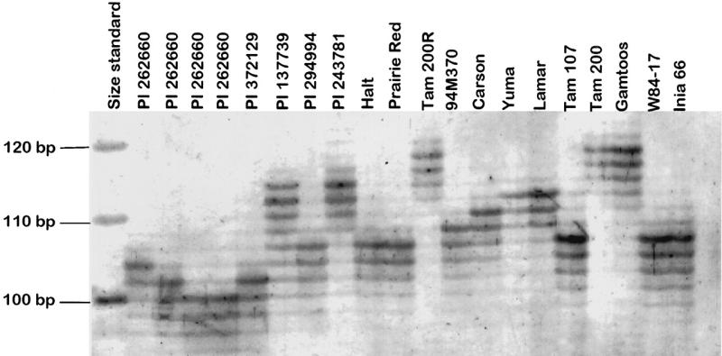
How do we sequence them?

Slide 8
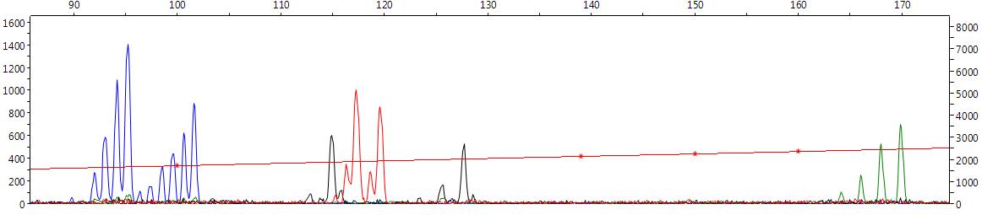
How do we sequence them?
Different color for different loci…
X-axis = fragment length (bp)
Y-axis=intensity
DNA polymerase doesn’t amplify simple repeats well, so we often get amplified fragments of an incorrect length (=‘stutters’)

Slide 9
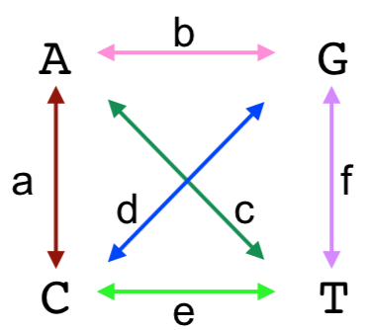
Disadvantages of using msats
Mutate too quickly for inferring deeper relationships (=noisy data)
Difficult to model how they evolve
Nucleotide Substitutions

Slide 10
Disadvantages of using msats
Mutate too quickly for inferring deeper relationships (=noisy data)
Difficult to model how they evolve
Nucleotide Substitutions

Slide 11
How do msats evolve?
Stepwise (add/remove 1 repeat at a time)?

Slide 12
How do msats evolve?
Stepwise (add/remove 1 repeat at a time)?
‘Stepwise Mutation Model’ (SMM)
Ancestral Sequence
TATG
TATG
TATG
TATG
-1
+1
Mutant 1
Mutant 2
TATG
TATG
TATG
TATG
TATG
TATG
TATG
TATG
-1
Mutant 3
Assumed due to replication ‘slippage’ by DNA polymerase
TATG
TATG

Slide 13
How do msats evolve?
Growth by >1 unit at a time?

Slide 14
How do msats evolve?
Growth by >1 unit at a time?
Two-phase Model (TPM)
Ancestral Sequence
TATG
TATG
TATG
-1
+2
Rate p
Rate p-1
Mutant 1
Mutant 2
TATG
TATG
TATG
TATG
TATG
TATG
TATG
+1
Mutant 3
Two rates: Growth by 1 and growth by >1
TATG
TATG
TATG

Slide 15
How do msats evolve?
Is it length dependent?

Slide 16
How do msats evolve?
Is it length dependent?
Centrally directed mutation (CDM)
Short alleles more likely to grow
Long alleles more likely to shrink

Slide 17
How do msats evolve?
We don’t know??

Slide 18
How do msats evolve?
We don’t know??
Infinite alleles model (IAM)
All mutations occur at equal probability
Repeat of 14 is assumed equally ‘related’ to repeat of 17 and repeat of 32
All that matters is ‘identical’ vs ‘different’

Slide 19
How do msats evolve?
Why do we care?
It means we cannot accurately construct a rate matrix and infer phylogeny from msats
Calculating genetic distance requires rate correction (remember saturation?)
Different measures of genetic distance assume different models of microsatellite evolution

